Slide 1
CloVers 🍀
GRAPH THEORY

Slide 2
01
02
Clovers
Graph Theory
03
04
Implementation
Application
Introduce our team members
Brief Introduction, Undirected , Directed
Adjacent matrix, Adjacent list
Maps
Social Networks
Web crawling

Slide 3
TEAM MEMBERS
DILYARA
TEMIRLAN
NAZERKE
TOMIRIS
SAYA

Slide 4

Nazerke Kulan
190103223 🤍
I love watching anime😍 ❤️
My hobby is to study 📚
I want to move to America 🇺🇸

Slide 5

Dilyara Kdyrova
190103436 🤍
My hobby is dancing
I want to become a successful programmer
Like to make beautiful notes

Slide 6

Temirlan Kadyr
190103490 🤍
Fav actress Alycia Debnam😍
My hobby is to watch TV series
I can masterfully fry eggs 🍳

Slide 7

Sessiyeva Tomiris
190103459 🤍
korean drama fan
I dream of working in Silicon Valley 😍
My hobby is reading books 📚

Slide 8

Atchibay Saya
190103410 🤍
Nature inspires me
I want to travel all over the world
I adore singing karaoke, even though I haven’t any voice

Slide 9


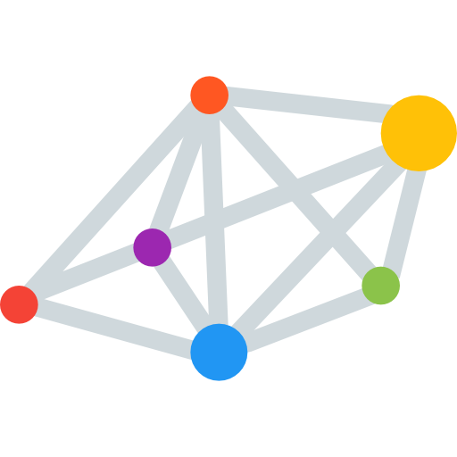
BRIEF INTRODUCTION
Graph theory is the mathematical theory of the properties and applications of graphs(networks).

Slide 10






edge
…………...……..
Edge
vertex

Slide 11






……………..………….…..……..
🤴🏻……………...…………….…..……..👸🏻
EDGE
………….…………….…..………..

Slide 12
BRIEF INTRODUCTION
👒
👠
💍
👚
🧢
👗
🩴
👜
👑
🩱
👡
👛
🎓
🥻
👢
A graph theory problem might be:
Given the constraints above, how many different sets of clothing can I make by choosing an article from each category?

Slide 13
BRIEF INTRODUCTION
👩🏻‍🎨
👩🏼‍🔧
👩🏻‍💻
👮🏻
👩‍🏭
🧑🏻‍✈️
👩🏻‍🏫
🤵🏻
👩‍💼
🧑🏼‍⚖️
Another example is a social network of friends.
This enables interesting questions such as: how many friends does person X have? Or how many degrees of separation are there between person X and person Y?

Slide 14
GRAPH
Undirected
directed
1
2
1
2
3
4
3
4

Slide 15
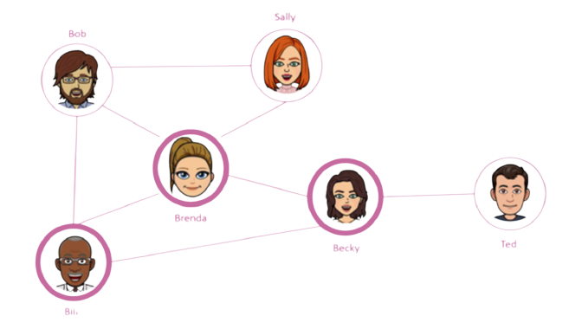
UNDIRECTED GRAPH
An undirected graph is a graph in which edges have no orientation. The edge(a, b) is identical to the edge (b, a).
a
b

Slide 16
TREES
Number of edges = number of vertices - 1
There is only one path between any two vertices
Connected and acyclic
01
02
03

Slide 17
TREE
B
A
C
D
E
F

Slide 18
NOT TREE
B
A
C
D
E
F

Slide 19
TREE
B
Num of edges = num of vertices - 1
A
C
D
Num of vertices = 6
Num of edges = 5
E
F

Slide 20
NOT TREE
B
Num of edges != num of vertices - 1
A
C
D
Num of vertices = 6
Num of edges = 6
E
F

Slide 21
TREE
B
A
C
D
E
F

Slide 22
NOT TREE
B
A
C
D
E
F

Slide 23
TREE
B
A
C
D
E
F

Slide 24
Trees application examples
((x + 7) * (-2)) > (2 - y)
<html>
>
<head>
<body>
*
-
<title>
<h2>
<ul>
+
-2
2
y
title
h2
<li>
<li>
x
7

Slide 25
B
A
C
D
E
F

Slide 26
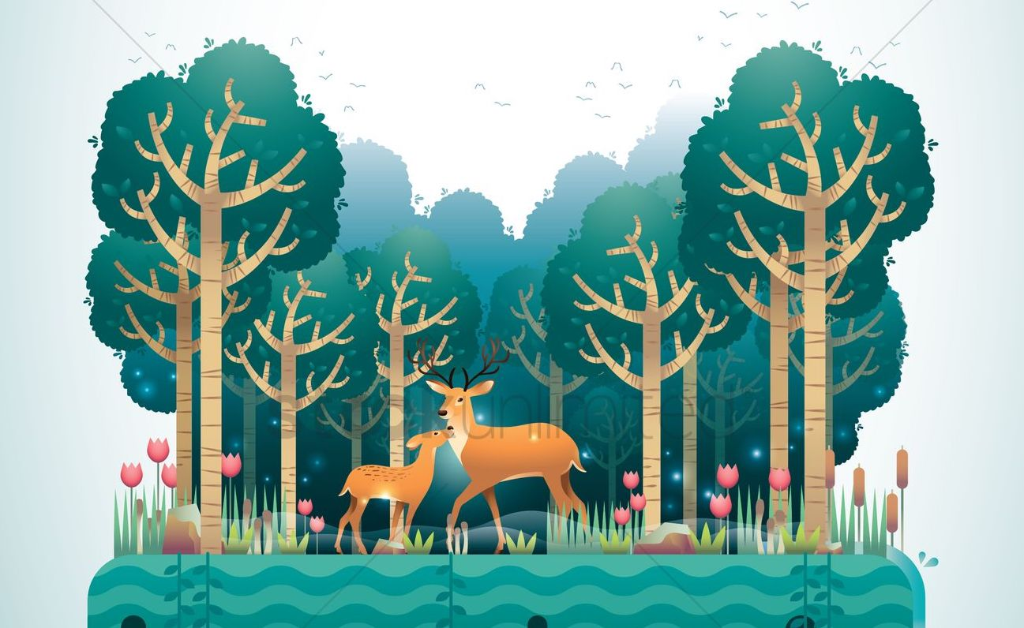
FOREST
Forest is an undirected, disconnected, acyclic graph. In other words, a disjoint collection of trees is known as forest. Each component of a forest is tree.

Slide 27
FOREST
B
A
G
Order = n - k,
where
n - total number of nodes
k - number of components(trees)
C
F
D
K
E
J
H

Slide 28
COMPLETE GRAPH
1
2
A
B
C
6
3
4
5
7
9
8

Slide 29
Directed Graph (Digraph)
A directed graph or digraph is a graph in which edges have orientations, the edges(u, v) is the edge from node u to node v.
A
B
E
C
D
F

Slide 30
Directed Acyclic directed Graphs(DAGs)
DAGs are directed graphs with no cycles. By definition it means all trees are automatically DAGs since they do not contain cycles.
Cool fact: All trees are DAGs but not all DAGs are out-trees.

Slide 31
Graph API
Public class Graph ------------------------------------------------------------------------------------------
Graph (int V) create an empty graph with V vertices
Graph (In in) create a graph from input stream
void addEdge (int v, int w) add an edge v-w
Iterable<Integer> adj(int v) vertices adjacent to v
Int V () number of vertices
Int E () number of edges
String toString () String representation

Slide 32
Graph representation
We will cover:
1 - Adjacency-matrix graph representation
2 - Adjacency-list graph representation

Slide 33
Adjacency-matrix graph representation
Adjacency matrix is a one of the popular method to represent a graph. It is a VxV matrix, where V is number of vertices. This matrix indicates whether pairs of vertices adjacent or not by putting 1 or 0 accordingly.
DEMO

Slide 34
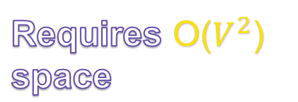
public AdjMatrix(int v) {
this.v = v;
arr = new int[v][v];
}
V x V
0
0
0
0
0
0
0
0
V
0
0
0
0
0
0
0
0
V

Slide 35
public AdjMatrix(int v) {
this.v = v;
arr = new int[v][v];
}
0 1 2 3
0
0
0
1
0
0
public void addEdge(int v, int w) {
arr [v][w] = 1;
arr [w][v] = 1;
}
0
1
0
0
0
1
0
1
1
0
0
0
2
Graph.addEdge(v: 0, w: 3);
0
1
0
0
0
1
3
Graph.addEdge(v: 2, w: 1);
Graph.addEdge(v: 2, w: 3);

Slide 36
0 1 2 3
0
0
0
1
0
0
3
0
0
1
0
1
0
1
0
1
2
1
2
1
0
1
0
3

Slide 37
How to determine if two nodes are connected?
I know how

Slide 38
if (arr[v][w] == 1) {
System.out.print(v + “ and ” + w + “ are connected vertices”);
}
0 1 2 3
0
0
0
1
0
Determining connectivity between 2 nodes: O(1)
0
0
1
0
1
0
1
0
1
2
1
0
1
0
3

Slide 39
Adjacency-list graph representation
One that most widely used in practice. We keep a vertex index array where for every vertex, we maintain a list of the vertices that are adjacent to that.
DEMO

Slide 40

0
…….
public AdjList(int v) {
this.v = v;
adj = new LinkedList[v];
for (int i = 0; i < v; i++) { adj[i] = new LinkedList<>();
}
}
1
…….
2
…….
Empty list for each vertex
3
…….
4
…….
5
…….
AdjList graph = new AdjList(7);
6
…….

Slide 41

public void addEdge(int v, int w) { adj[v].add(w);
adj[w].add(v);
}
0
1
2
6
5
1
0
2
0
graph.addEdge(v: 0, w: 1);
3
5
graph.addEdge(v: 0, w: 2);
4
graph.addEdge(v: 0, w: 6);
5
0
3
graph.addEdge(v: 0, w: 5);
6
0
graph.addEdge(v: 5, w: 3);

Slide 42
public void addEdge(int v, int w) { adj[v].add(w);
adj[w].add(v);
}
0
1
2
6
5
1
0
2
0
graph.addEdge(v: 3, w: 4);
3
5
4
4
3
6
graph.addEdge(v: 6, w: 4);
5
0
3
6
0
4

Slide 43
How this graph looks like?
0
6
2
1
3
4
5

Slide 44
Adjacency Matrix
Small conclusion:
Adjacency List
Space:
O(|V|+|E|)
O(|V^2|)
addVertex:
O(1)
O(|V^2|)
removeVertex:
O(|V|+|E|)
O(|V^2|)
addEdge:
O(1)
O(1)

Slide 45
Applications
Graph Theory is used in vast area of science and technologies.
shortest path algorithms
crawling a network
job scheduling algorithms
software engineering
strongly connected components

Slide 46
Google Maps – it’s just one big graph
Graph theory is used to find shortest path in road or a network. In Google Maps, various locations are represented as vertices or nodes and the roads are represented as edges and graph theory is used to find the shortest path between two nodes.

Slide 47
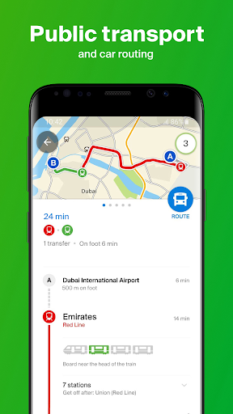
2GIS
Dijkstra’s algorithm and Prim’s algorithm is used to determine the shortest distance between any two vertices, with the aid of imaging.

Slide 48
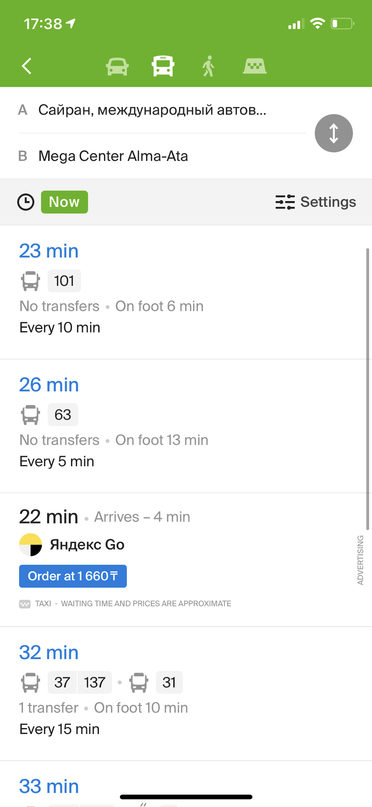
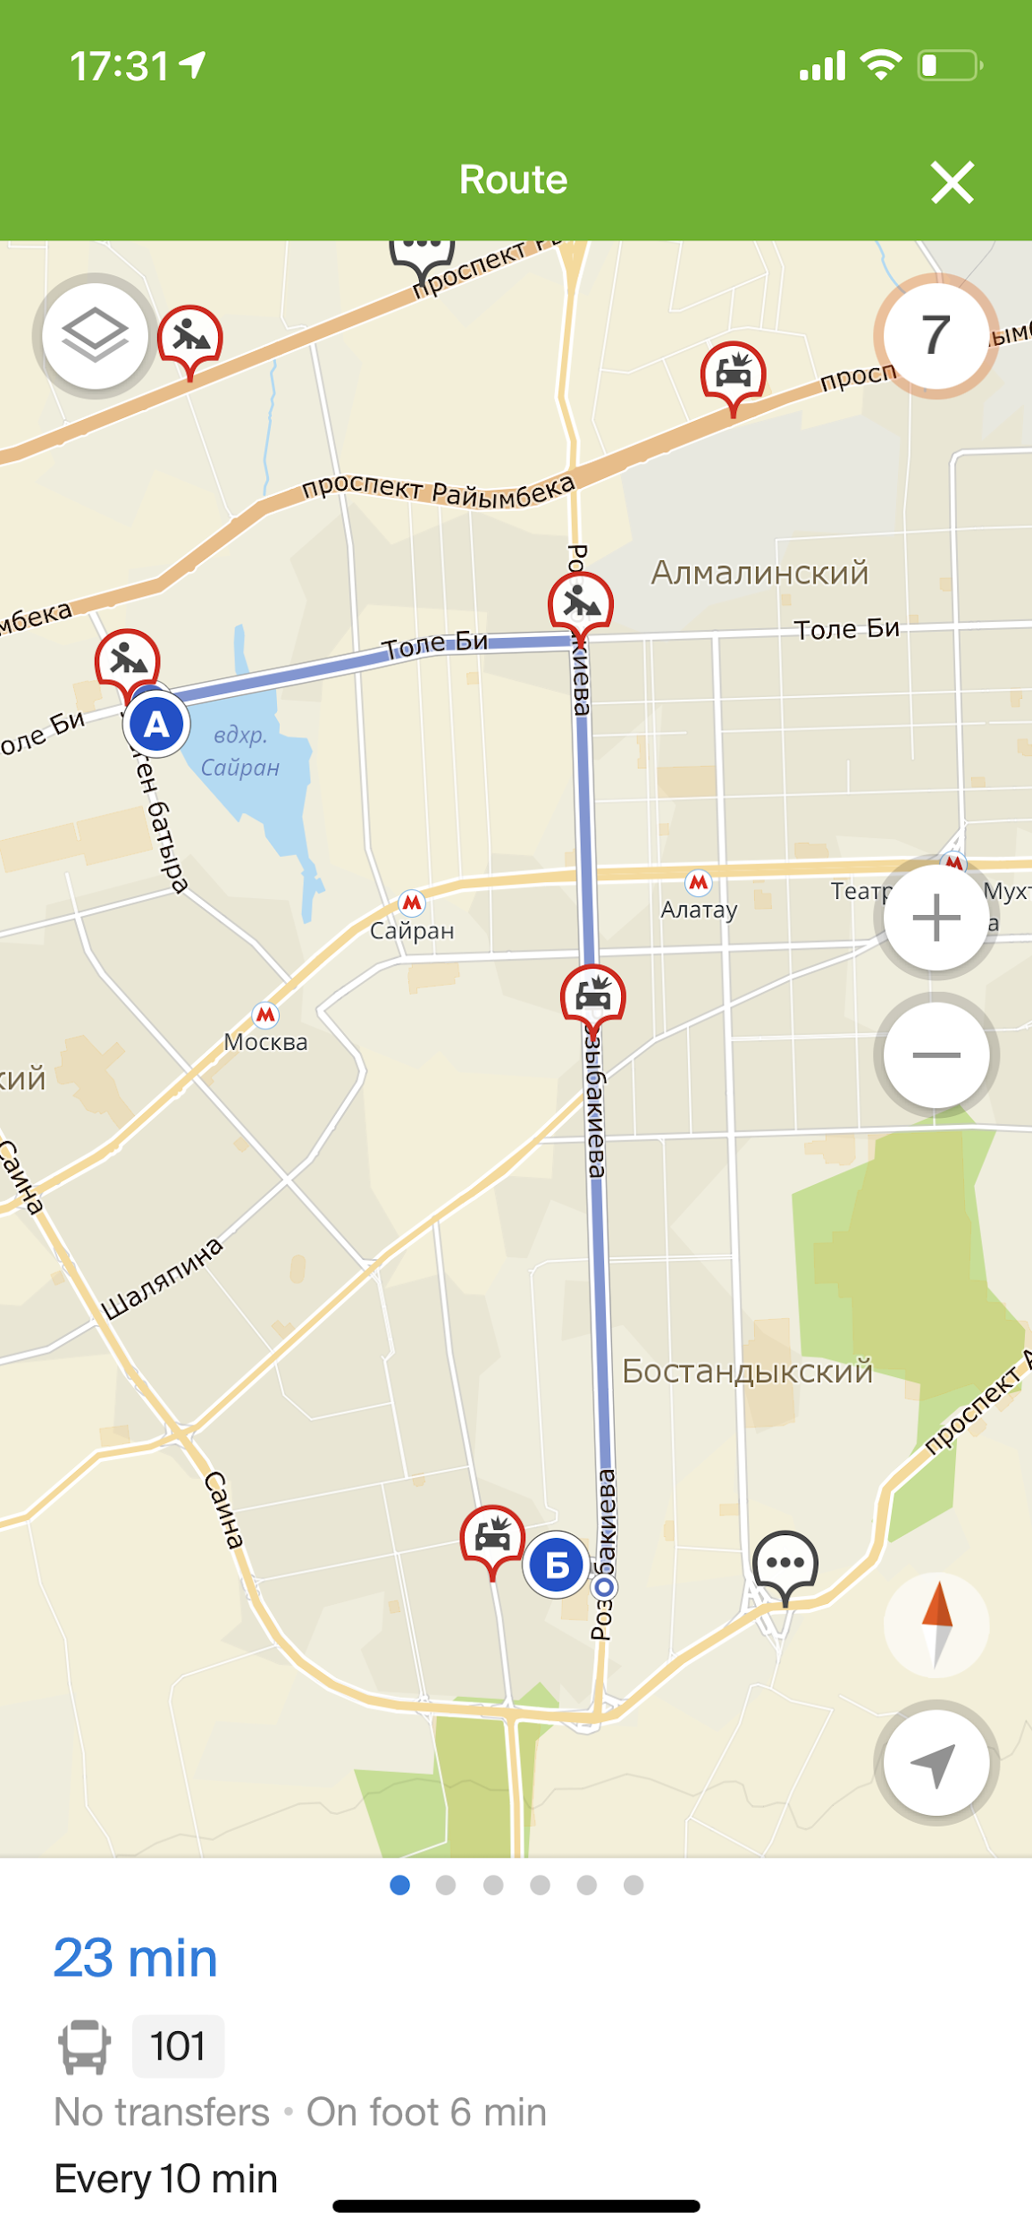
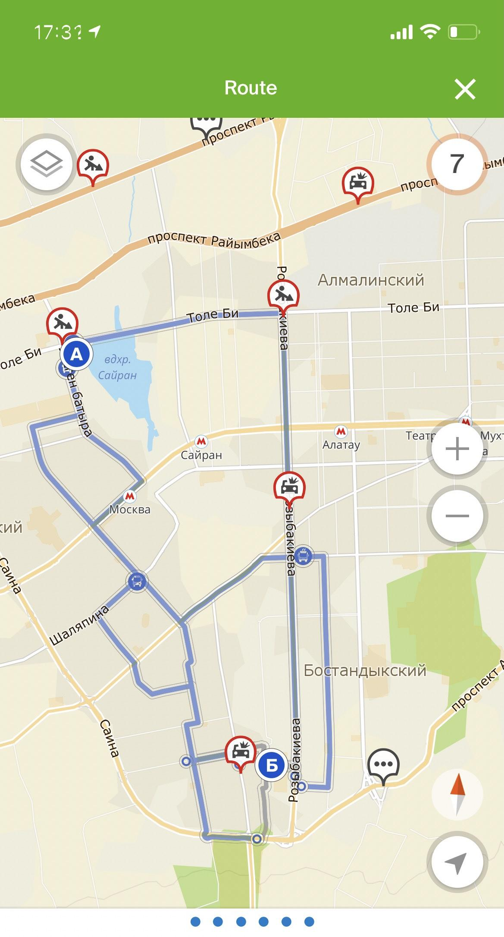
2GIS
Shortest way
You can replace the image on the screen with your own work. Just delete this one, add yours and center it properly

Slide 49

2GIS
Graph representation
You can replace the image on the screen with your own work. Just delete this one, add yours and center it properly

Slide 50

Social Networks
Social networks can be described as a graph of individuals who all come in contact with each other. This can take a form similar to Facebook where individuals ”friend” each other in a process known to all of us on social media. Networks can also form in real life at a college where individuals form a large-scale network based on club involvement and students belonging to multiple clubs

Slide 51








Graph in Instagram
@in_my_other_world
@sayook_
@kdyrovadd
@temirlan38
@sessiyeva

Slide 52
Graph in Social Networks
1
all edges are undirected, without one vertex pointing to another.
3
edges are unweighted. All ”bonds” within a network
are assumed to be equal.
2
the graph must be simple with no vertices connecting to themselves at all or other vertices multiple times.
4
the graph of a single network must be connected.

Slide 53


Web Crawling
Webcrawler is a very important application of the graph (BFS). The idea is that the whole internet can be represented by a directed graph:
Vertices -> Domains/ URLs/ Websites.
Edges -> Connections.

Slide 54
Thank you for attention!

